Slide 1
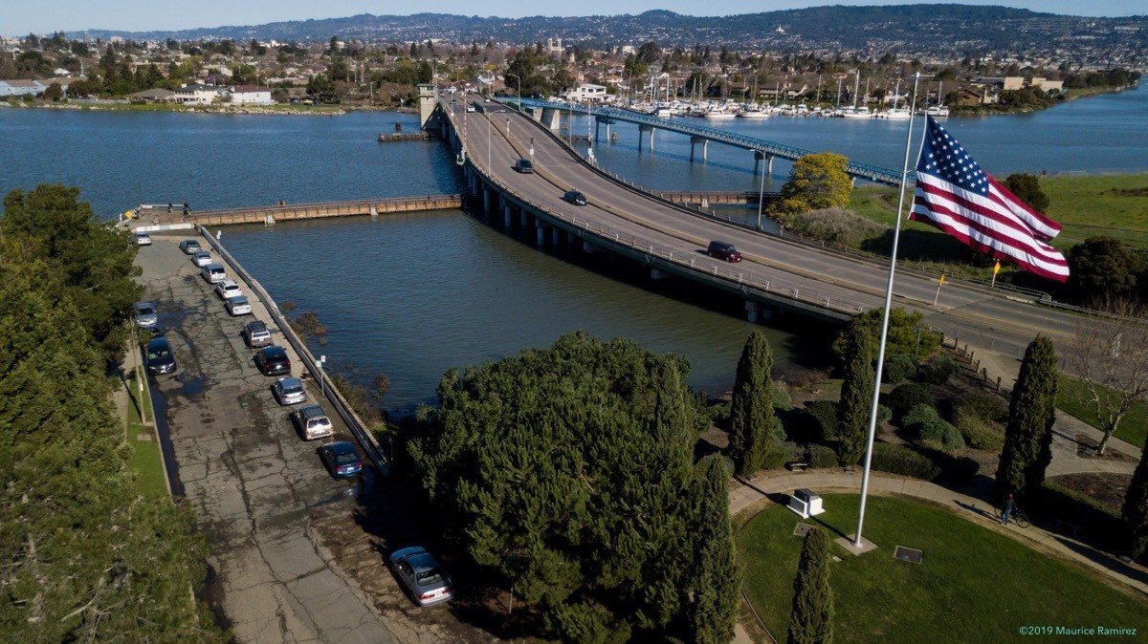
Protecting the Bay Protecting Alameda
Water Quality & Flood Protection Initiative
2019

Slide 2
Discussion Outline
Essential Community Values
Realizing Values = Clean Water Program
The Challenge
The Need
Meeting the Challenge
Community Outcomes
Consequences of No Action
Next Steps
Q&A

Slide 3
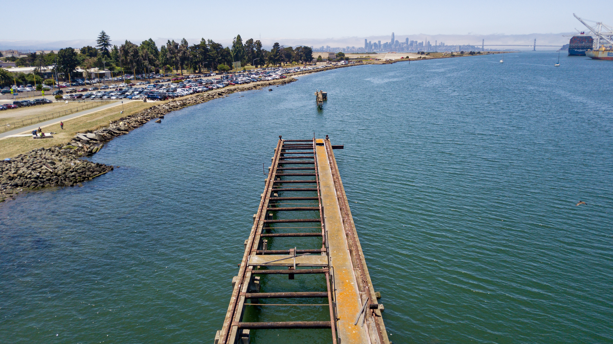
Alameda Clean Water Values
Protecting the Bay
Sustainable storm drains
Protecting property

Slide 4
Clean Water Program
Clean Water Program = means to achieve community values
Four key elements to program
Operations & Maintenance
Water Quality
Capital Investments
Coastal Flooding & Sea Level Rise Protection

Slide 5
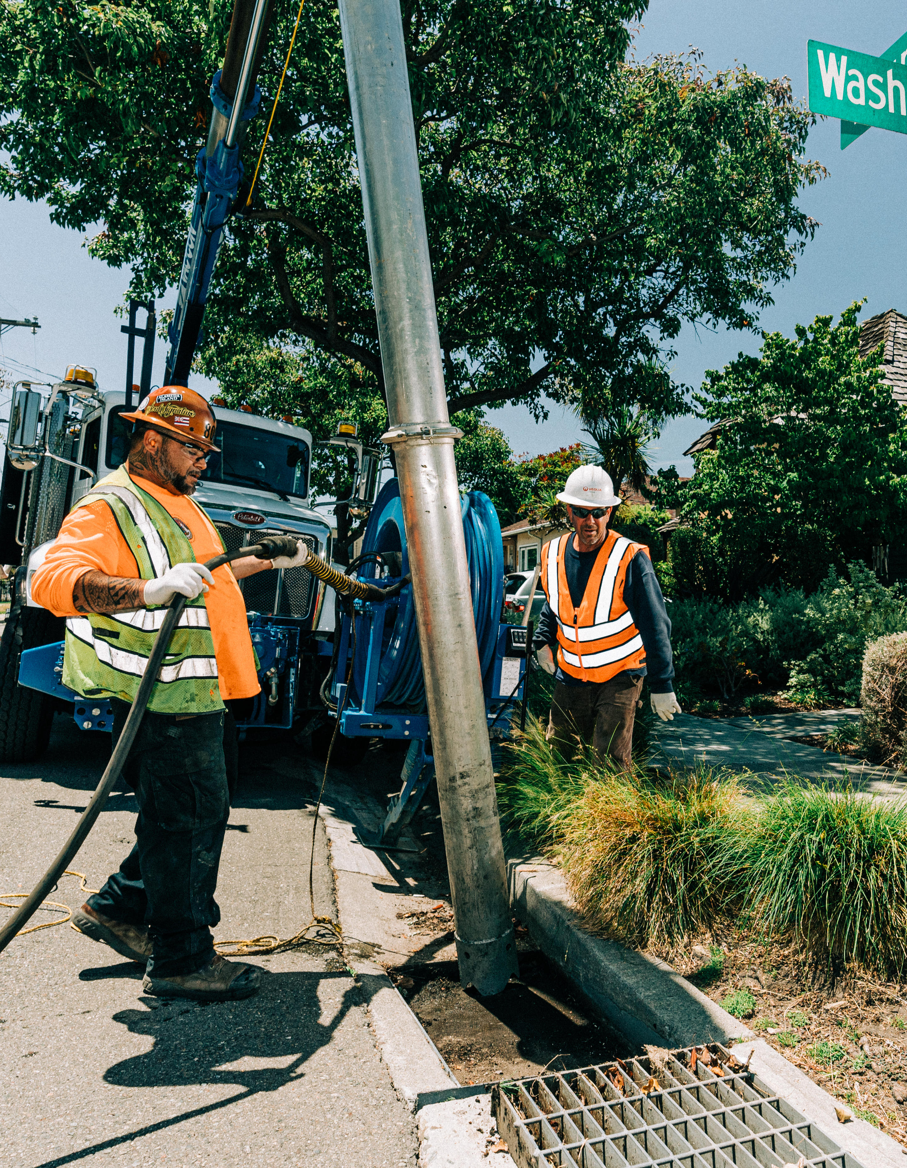
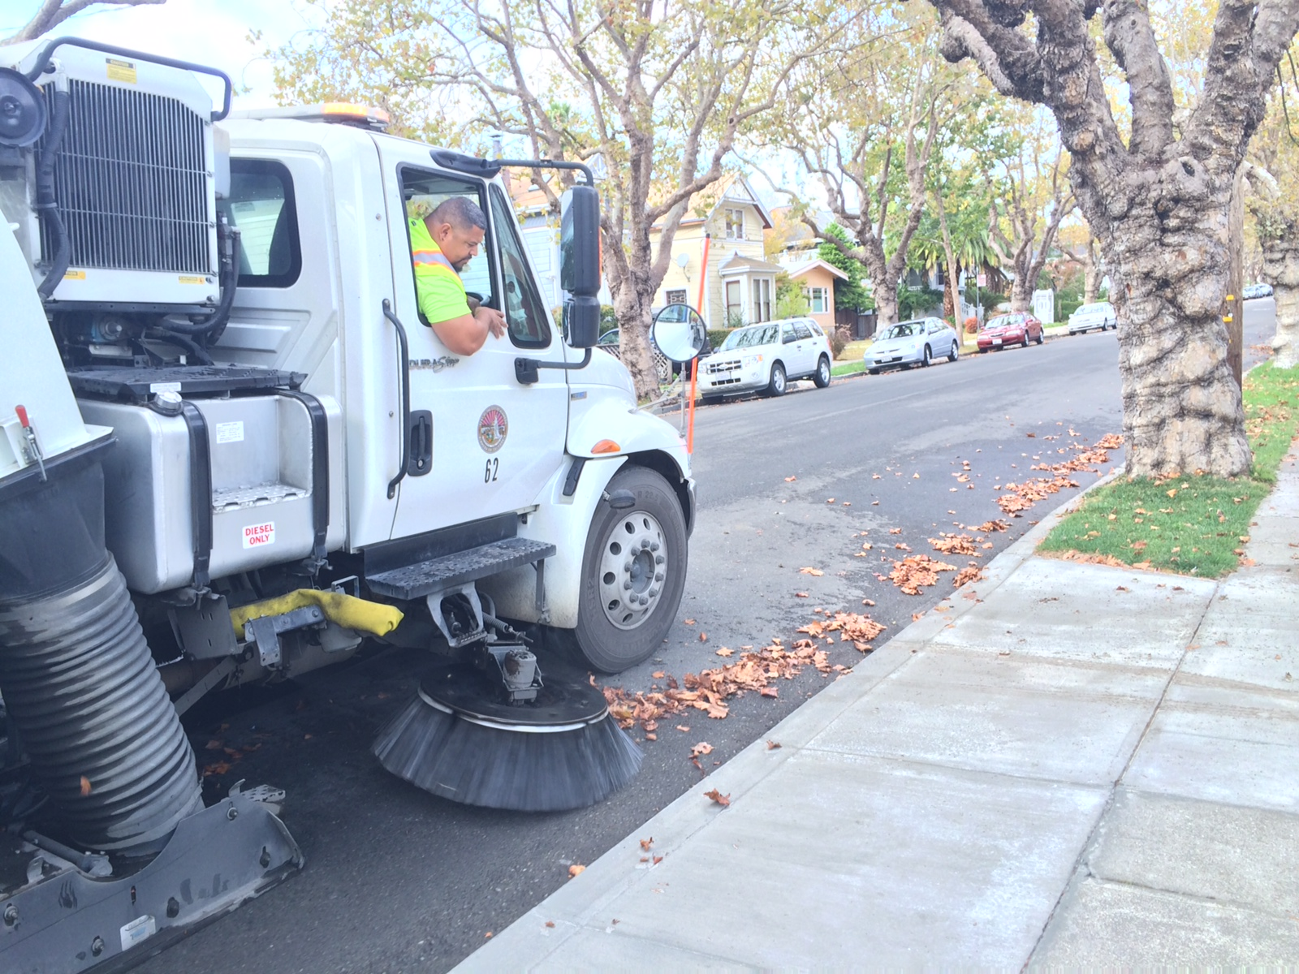
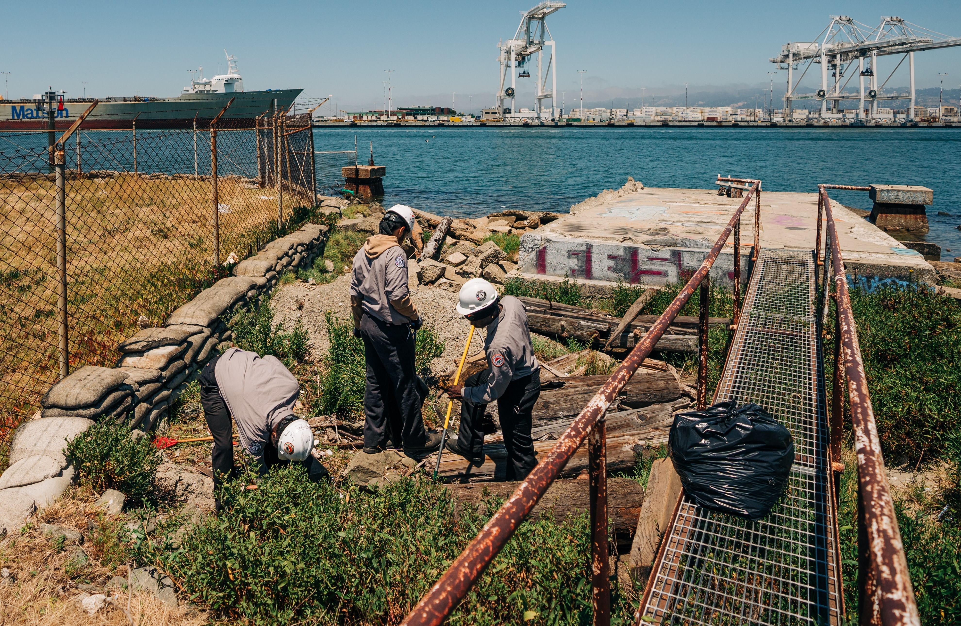
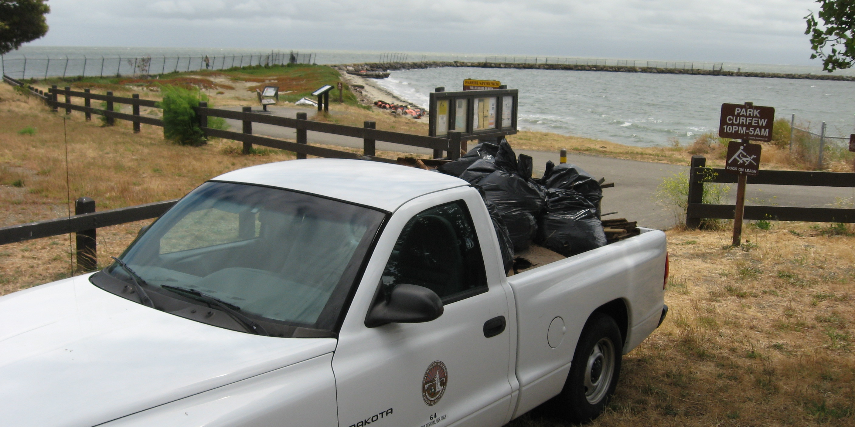
What is the City’s Program?
Operations & Maintenance
Trash capture removal
Storm response
Lagoon maintenance & monitoring
Storm drain inspection & cleaning
Street sweeping

Slide 6
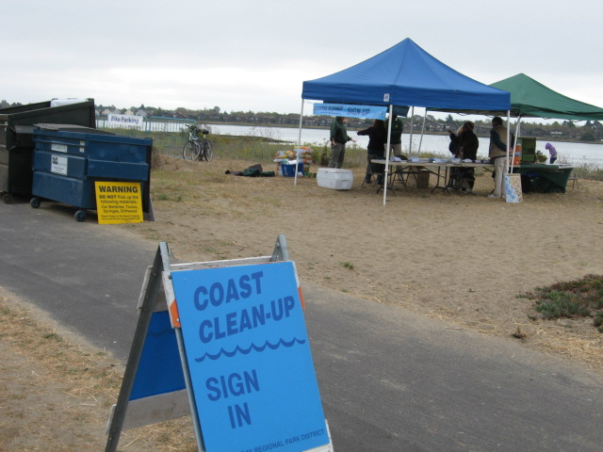
What is the City’s Program?
Water Quality
Trash Reduction Planning
Green Infrastructure Planning
Shoreline/Beach Clean Ups
Pollution Prevention
Inspections – Restaurants, Construction sites & illegal discharge
Development oversight

Slide 7
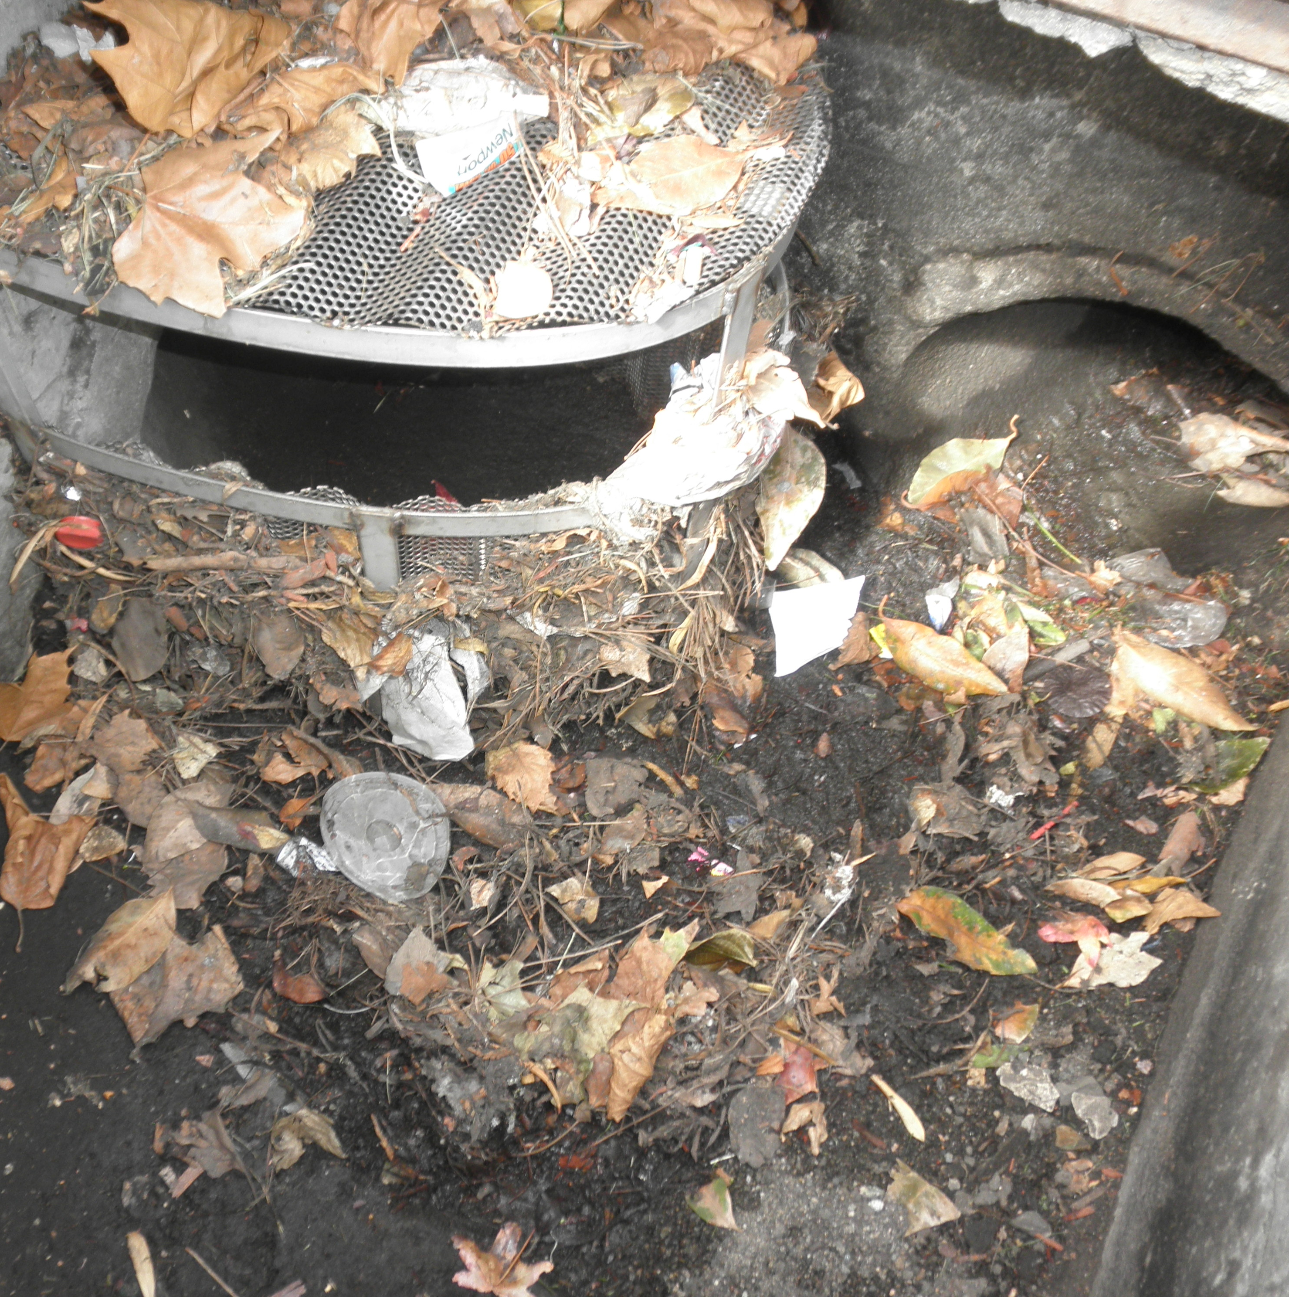
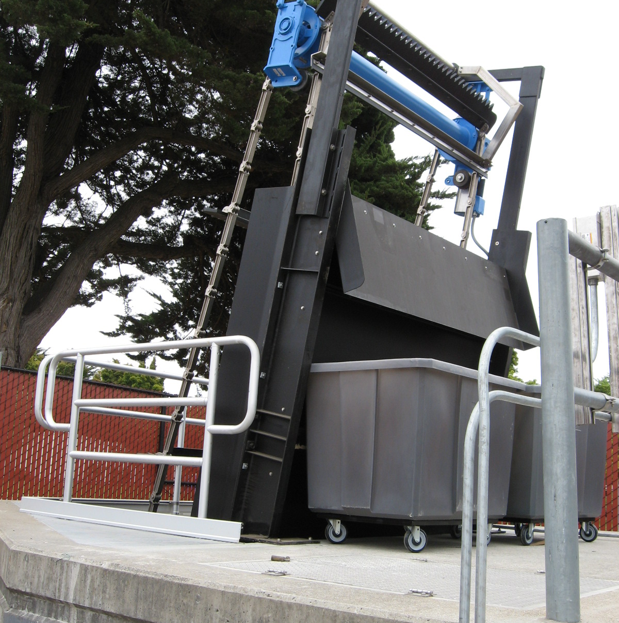
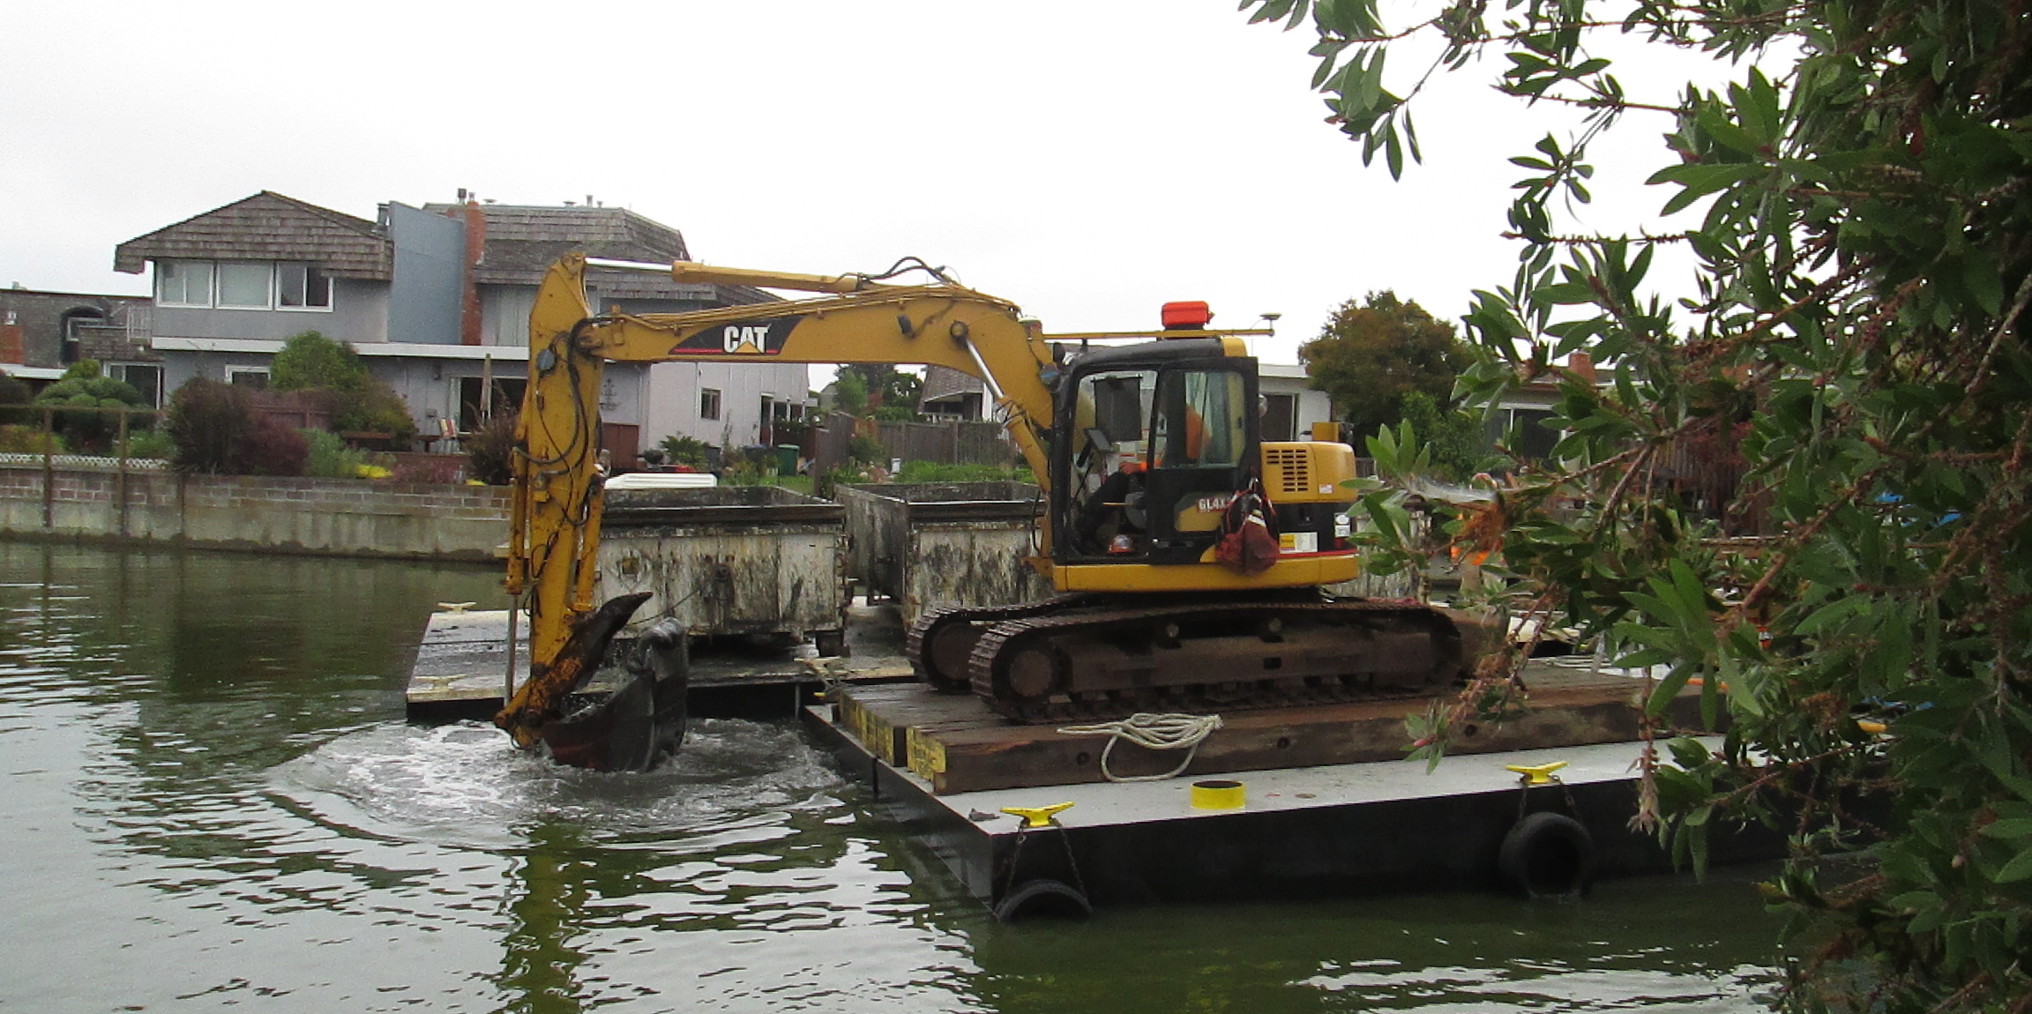
What is the City’s Program?
Capital Investments
Retrofit or upsize 3 pump stations
Storm drainage system upgrades
Local Intersection culvert replacement
Upgrades to storm drain pipes, catch basins & manholes
Lagoon dredging
Green infrastructure & trash capture devices

Slide 8
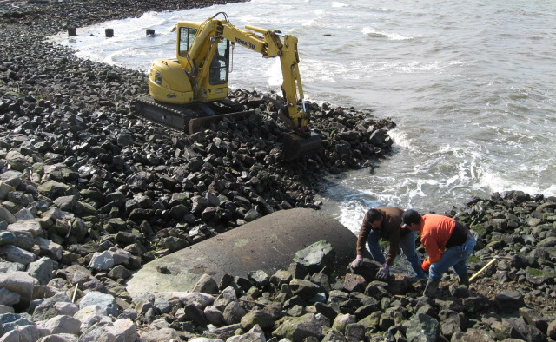
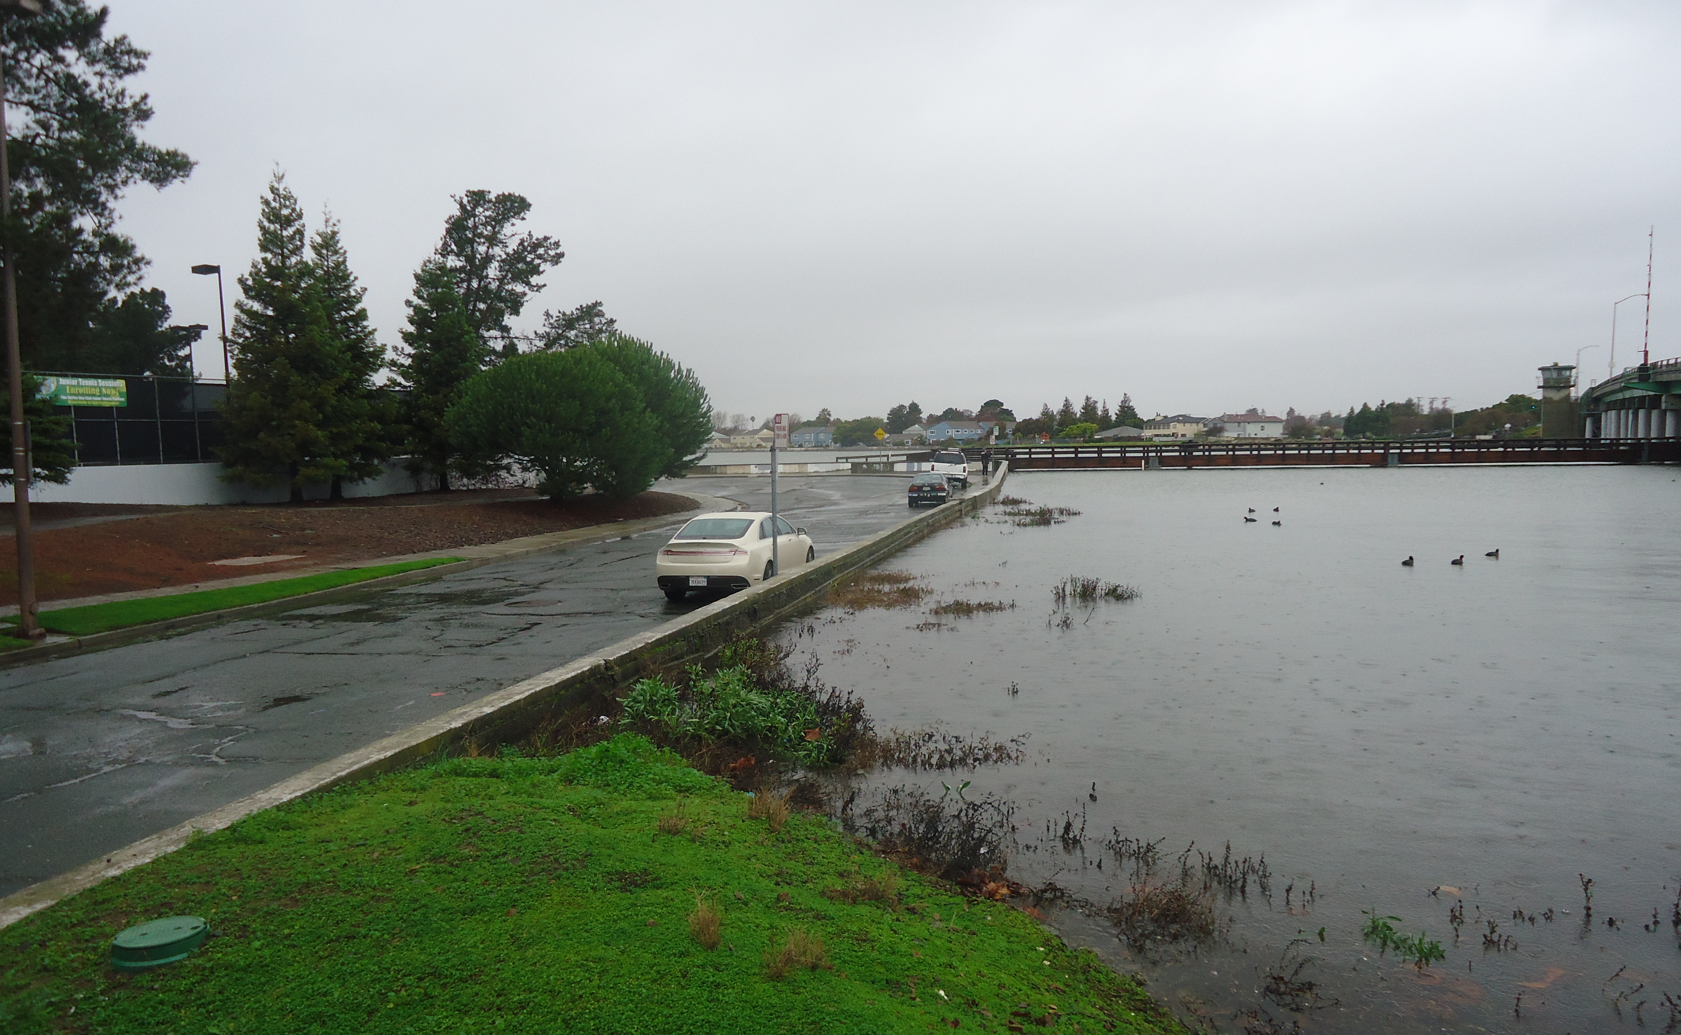
What is the City’s Program?
Coastal Flooding & Sea Level Rise Protection
Climate change planning
Improved and increased capacity pump stations & pipes
Perimeter levee infrastructure
Shoreline improvements

Slide 9
Why is City Implementing Program?
Achieve Clean Water Values
Keep roadways clear for traveling public
Protect local shorelines, the Bay & beaches
Protect property from local flooding

Slide 10
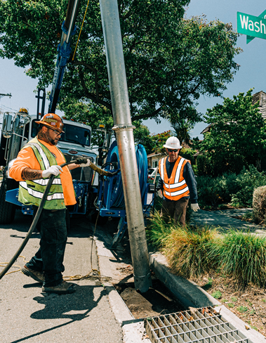
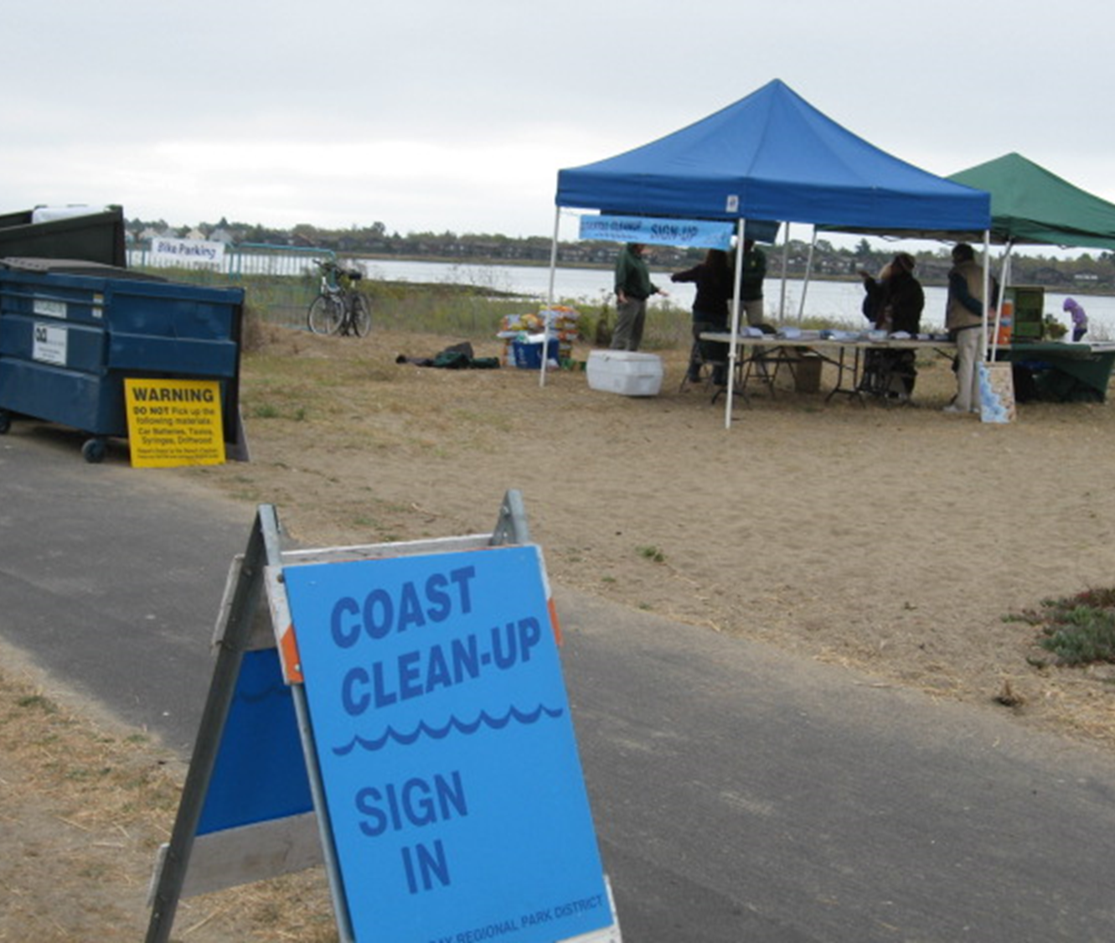
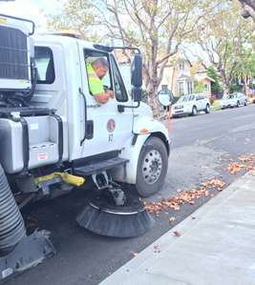
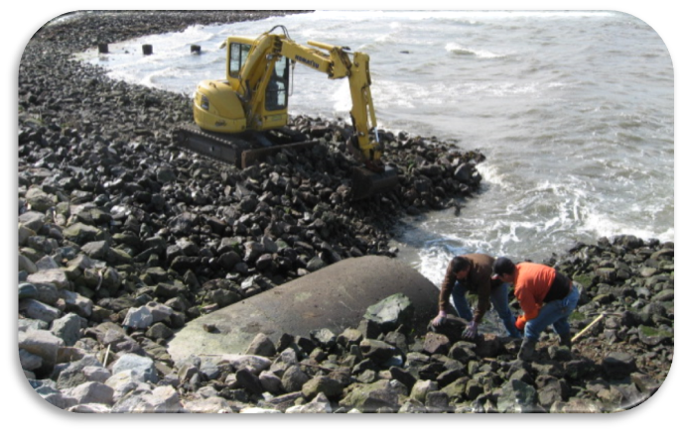
The Challenge
Fund is unsustainable
$1M/year deficit
Fund balance depleted
$30M+ in capital needs

Slide 11
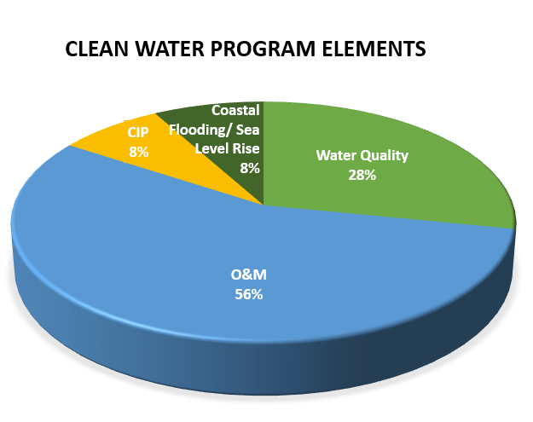
The Need
~$5.5M/year
$1.5M Water Quality 28%
$3.1M O&M 56%
$450k Capital 8%
$450k Coastal Flooding & Sea Level Rise 8%

Slide 12
Meeting the Challenge
Dedicated & sustainable local revenue
Strong local fiscal oversight
Prop 218 compliant
Property related
Fair share of runoff contributed
Example Rates for Single Family Residential in 2020/2021
 | Month | Year
Proposed | $6.50 | $78.00
Existing | $4.67 | $56.00
Total | $11.17 | $134.00

Slide 13
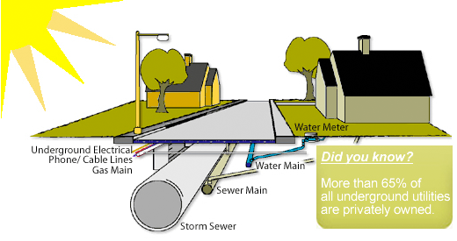
Storm Drain Fee Context
Water & Sewer Bills
Water & Sewer Bills
PG&E and Comcast Bills
Average Monthly Bills
$150 – Comcast
$150 – PG&E
$60 – Water (winter)
$24 – Sewer
$4.6 – Current Storm Drain
$6.5 – Proposed Add’l Storm Drain
Storm Drain Bill
Storm Drain

Slide 14
Prop 218 Requirements & Process
Adopt Fee Study 7/16/19 Complete
Public Notice 8/14/19 Complete
Public Hearing 10/1/19
Mail Ballots 10/10/19
Ballot Closing 11/25/19
If Approved – Council Resolution 12/3/19
If Approved – Fees Implemented Nov. 2020 Tax Bill
Prop 218 Key Requirement
Vote of Property owners
Requires 50% + 1 majority to approve
One parcel = One vote
Prop 218 Timeline

Slide 15
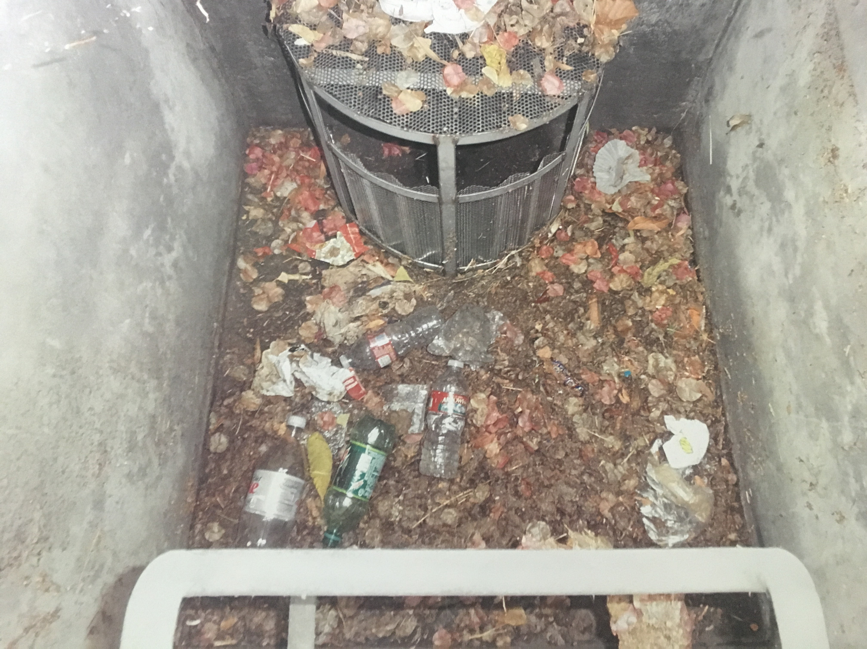
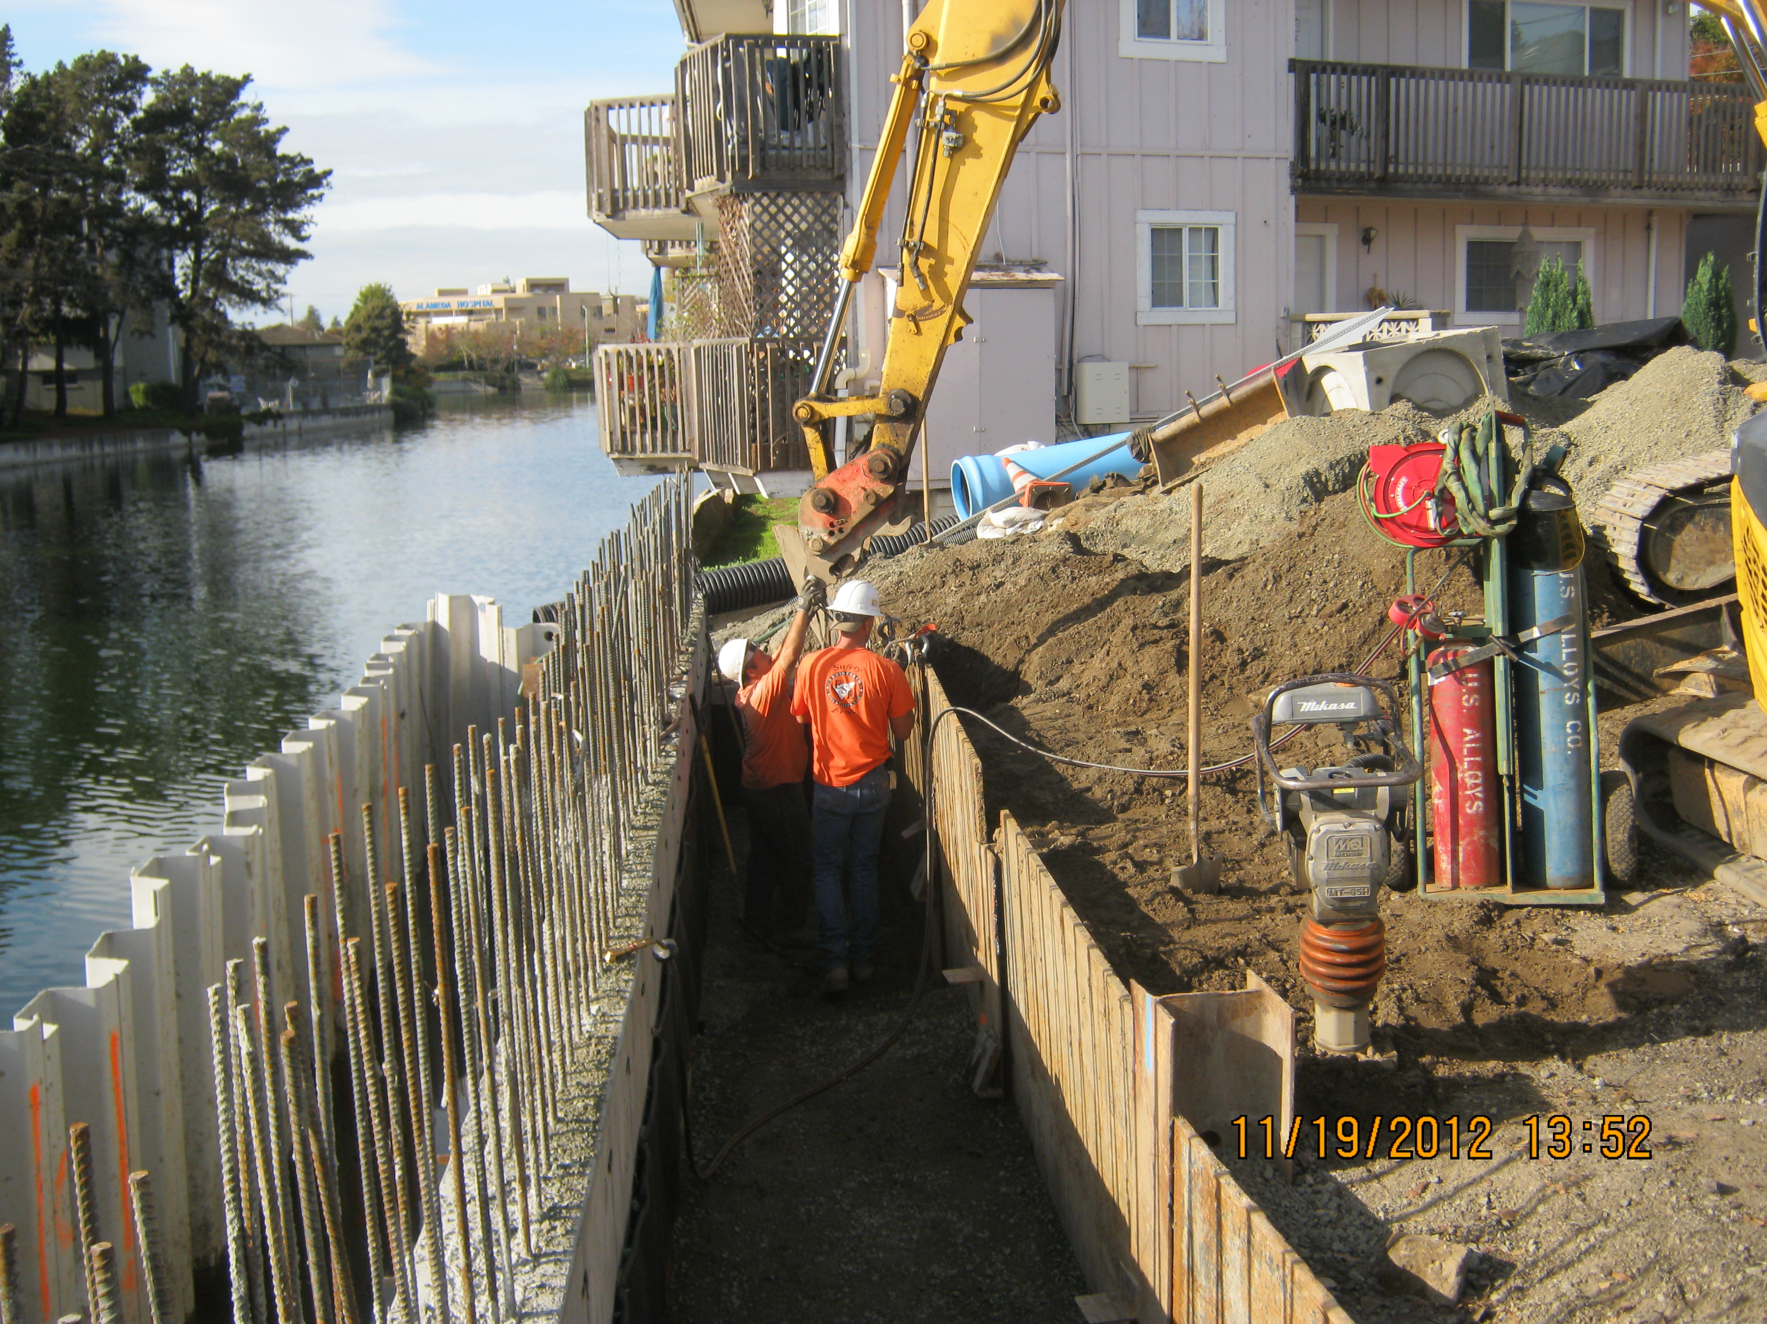
Community Outcomes
Protecting Property
Protecting the Bay
Sustainable Storm Drains
Trash Clean-Up
Reduced Pollution
Storm Response
Street Sweeping
Reduced Flooding
Protection from Sea Level Rise

Slide 16
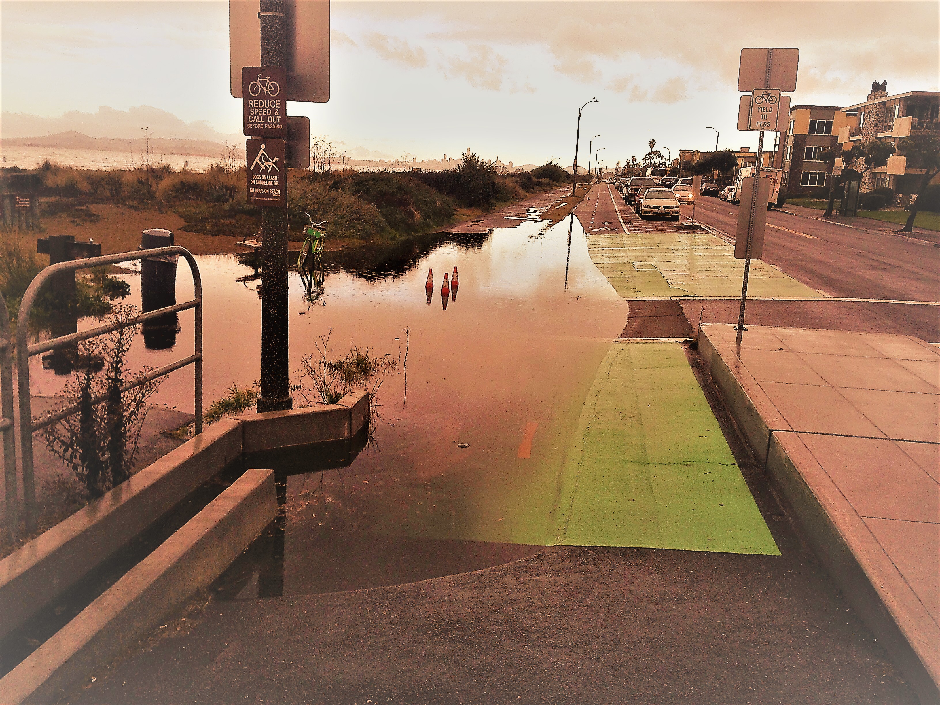
What Happens if We Don’t Take Action?
Fund depleted = Reduced level of service
Reactive program
Longer response times
Reduced storm drain maintenance
Less street sweeping
No stormwater capital projects
Risk of catastrophic failure increases
Inability to adapt to climate change & sea level rise

Slide 17
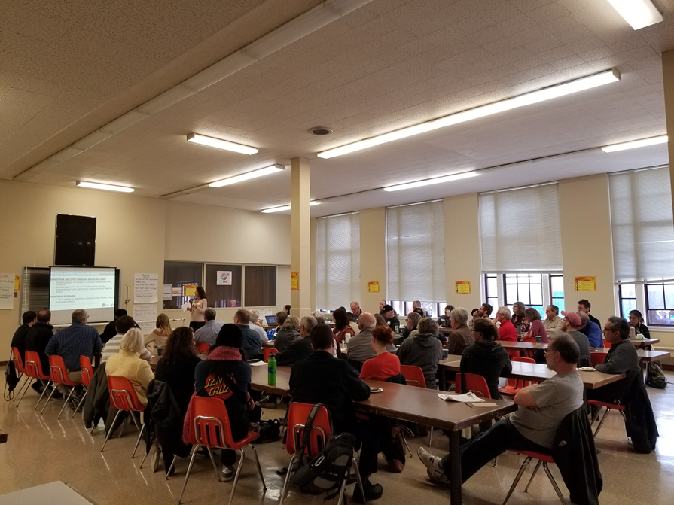
Next Steps
Right Now
Q&A and Comment Cards
Equipment and Operators
Later
Outreach Aug-Sept 2019
Community Meetings
August 28, 2019
September 10, 2019
Public Hearing Oct. 1, 2019
Balloting Oct-Nov, 2019
Liam Garland, PW Director, lgarland@alamedaca.gov
Sarah Henry, PIO, shenry@alamedaca.gov
alamedaca.gov/cleanwater

